Slide 1

IS4302 Project
Alvin Lim Wei Qiang
Cheong Yi Wei
Chua Wei Han
Ng Gin Wen
A0139940Y
A0144713L
A0139703E
A0142949U
Notes:
Good afternoon everyone, my group consists Alvin, Yiwei, Weihan and myself. Today, we would be introducing to you the charity blockchain model that we have implemented.

Slide 2

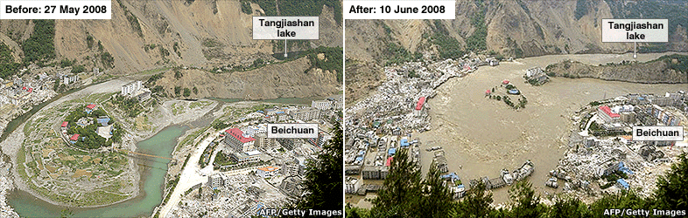
Previously…
2008 China Sichuan Earthquake
Notes:
Just to recap, previously we have talked about how donation funds were misappropriated during the 2008 Sichuan Earthquake. Unsurprisingly, just recently, in Singapore, a similar incident happened again.
Problems:
Donations were carried out mostly in cash which is untraceable
Trust misplaced on person of authority. Transparency is needed to allow donors and beneficiaries to be more well-informed.

Slide 3
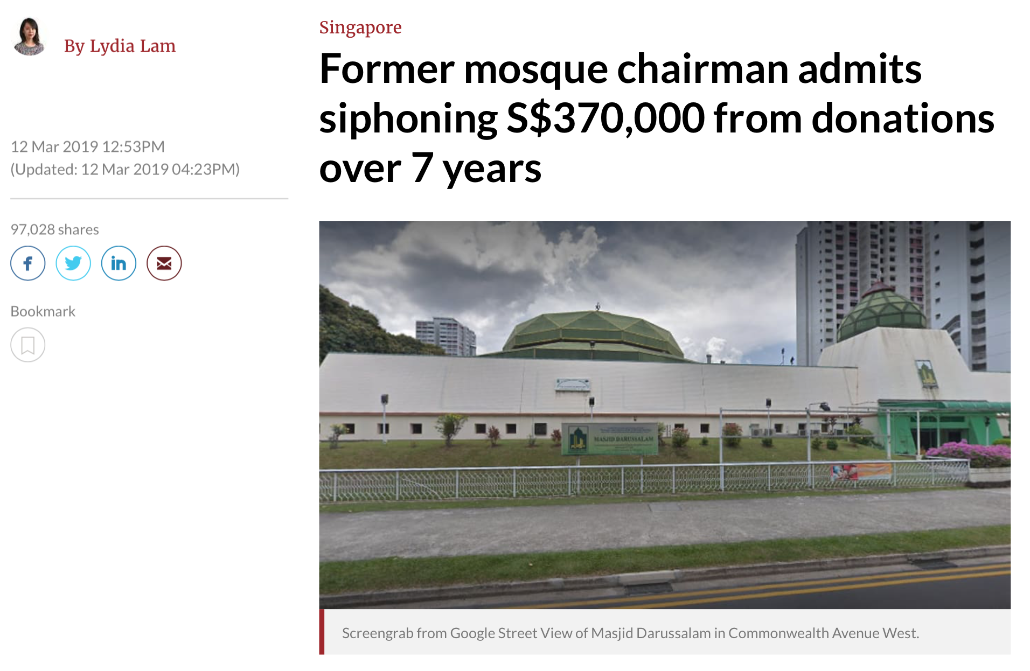
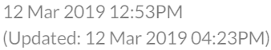
Recently in March 2019...
Misappropriation of Funds
Recurring Incidence
Undiscovered for Years
Notes:
So in March, Singapore reported that a former mosque chairman admitted to siphoning $370,000 from donations over 7 years. From the headline, we can gather that misappropriation of funds happened and furthermore it has been undiscovered for years. The incident also shows that donation misappropriation is a recurring incident and there is a need to come up with a solution to curb this.
Previously talked about Sichuan Earthquake
Just recently, in Singapore, misappropriation of funds happened again
Shows that it is a recurring incident
Problems:
Donations were carried out mostly in cash which is untraceable
Trust misplaced on person of authority. Transparency is needed to allow donors and beneficiaries to be more well-informed.

Slide 4
Recently in March 2019...
“Those who visited the mosque gave donations by placing cash into donation chests and containers inside the mosque, labelled "tabung jumaat" or Friday collections and "tabung kebajikan" or welfare collections.”
Misappropriation of Funds
Recurring Incidence
Undiscovered for Years
Untraceable Cash Donations
Notes:
What are some of the causes that could allow for the misappropriation of funds to happen? Firstly, donations were given in cash. This mean that these cash donations are untraceable and there is no recording of the transaction. That’s why we need traceable blockchain transactions.
Previously talked about Sichuan Earthquake
Just recently, in Singapore, misappropriation of funds happened again
Shows that it is a recurring incident
Problems:
Donations were carried out mostly in cash which is untraceable
Trust misplaced on person of authority. Transparency is needed to allow donors and beneficiaries to be more well-informed.

Slide 5
Recently in March 2019...
“He was chairman of the mosque management board between 2003 and August 2010, continuing as voluntary chairman up to March 2013.
Mutalif was also the executive director of the Just Parenting Association (JPA) which he had set up, and the president of registered charity Association for Devoted and Active Family Men (ADAM).”
Misappropriation of Funds
Recurring Incidence
Undiscovered for Years
Untraceable Cash Donations
Misplaced Trust on Person of Authority
Notes:
Next, we can see that this former mosque chairman held many key roles across many organisations. He had authority, but he misused his authority to carry out unethical transactions. There is thus misplaced trust which would not be an issue in a blockchain framework.
Previously talked about Sichuan Earthquake
Just recently, in Singapore, misappropriation of funds happened again
Shows that it is a recurring incident
Problems:
Donations were carried out mostly in cash which is untraceable
Trust misplaced on person of authority. Transparency is needed to allow donors and beneficiaries to be more well-informed.

Slide 6
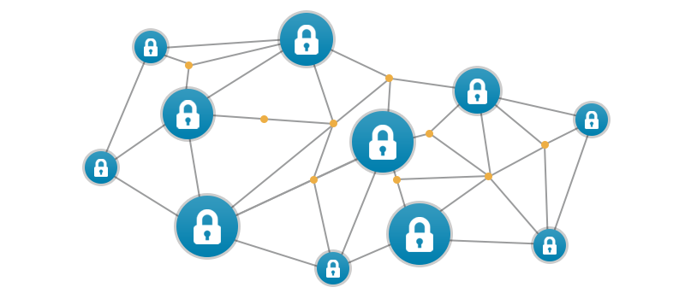
Motivation
Pain Points in Case Study
Intended Outcome:
Solution:
Misappropriation of Funds
Ensure Donated Funds goes to Beneficiaries
Donation Blockchain Model
Recurring Incidence
Reduce Such Incidents
Undiscovered for Years
Discovered Instantly
Untraceable Cash Donations
Traceable Blockchain Transactions
Misplaced Trust on Person of Authority
Well-Informed Donors and Beneficiaries
Notes:
To summarise, from the case study, we can see some of the pain points that is present when it comes to donations. Hence, to explain how our donation blockchain model would be useful, with regard to this case study, we expect the blockchain model to help ensure donated funds goes to beneficiaries. And as blockchain transactions are traceable and donors as well as beneficiaries are well informed since they can view relevant details, misappropriation can be discovered instantly and there would be a reduction in such cases from happening. Now, I will pass my time to Alvin to elaborate more about the blockchain process.
Previously talked about Sichuan Earthquake
Just recently, in Singapore, misappropriation of funds happened again
Shows that it is a recurring incident
Problems:
Donations were carried out mostly in cash which is untraceable
Trust misplaced on person of authority. Transparency is needed to allow donors and beneficiaries to be more well-informed.

Slide 7
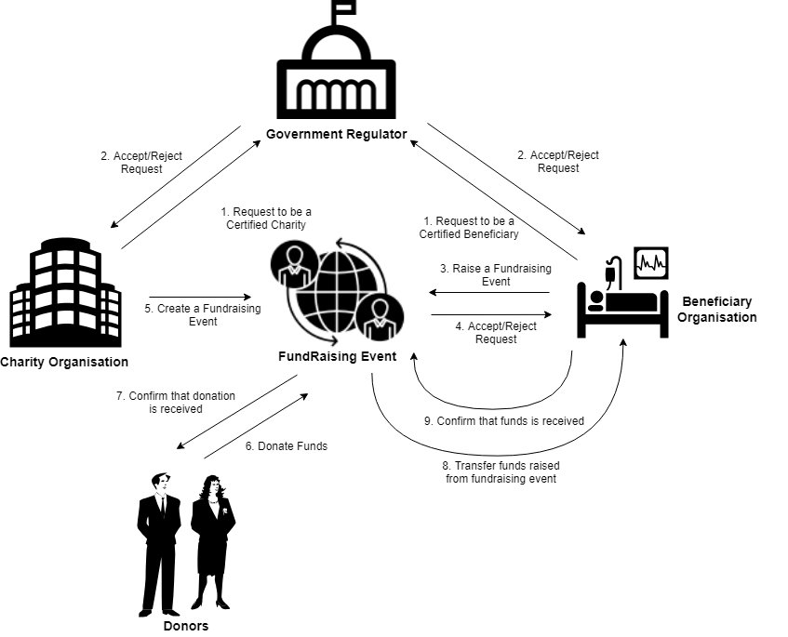
Overview of Process

Slide 8
Selling Point
Eliminates the issue of funds misappropriation
Records are immutable and irrevocable once committed
Addresses the issues of transparency, traceability and accountability of funds
Improves trusts among donors, charities and beneficiaries

Slide 9

Demo

Slide 10
Thank You!

